Slide 1
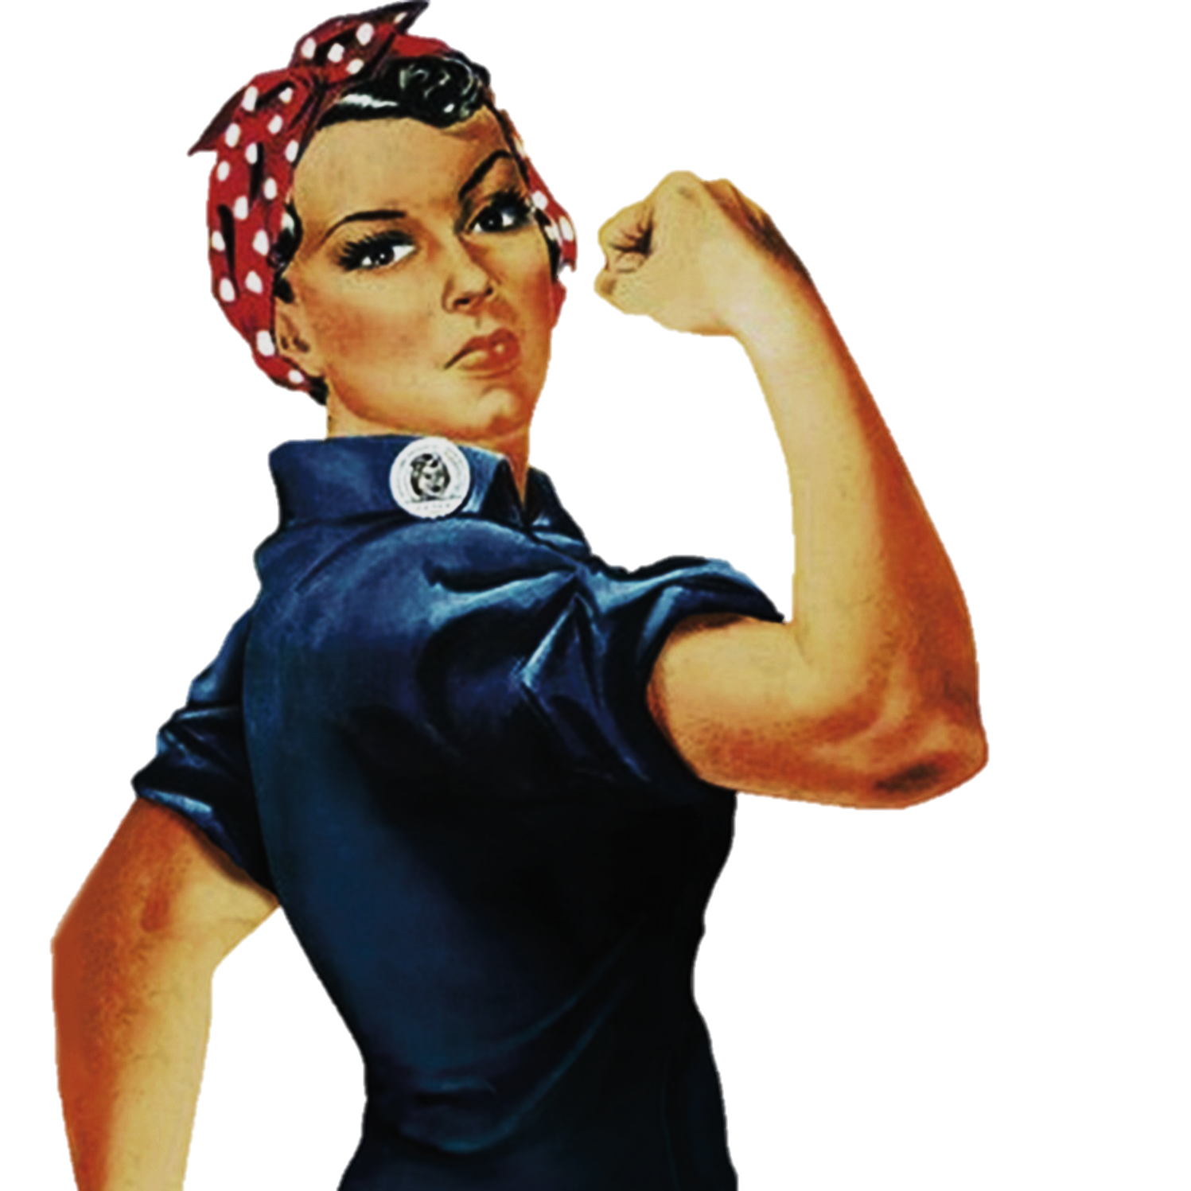
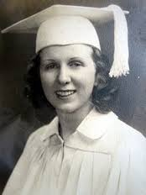
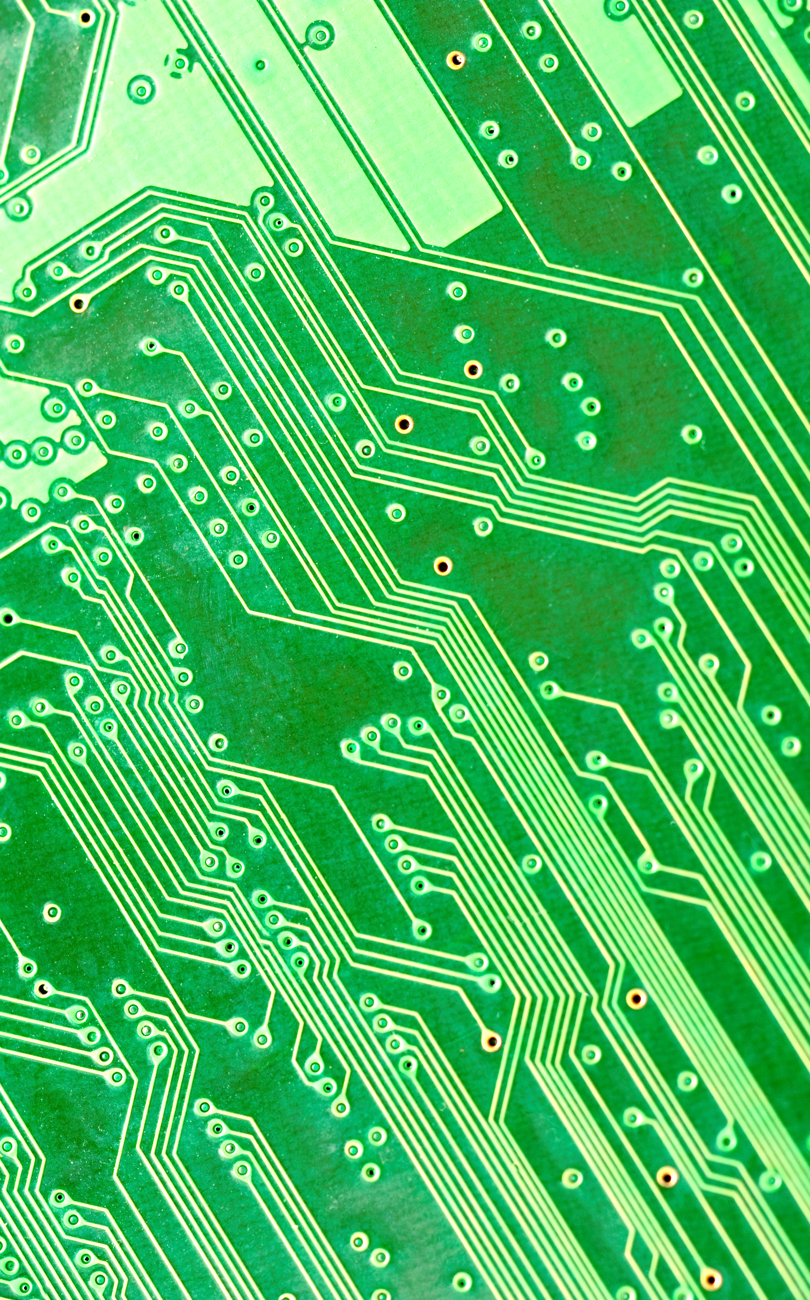
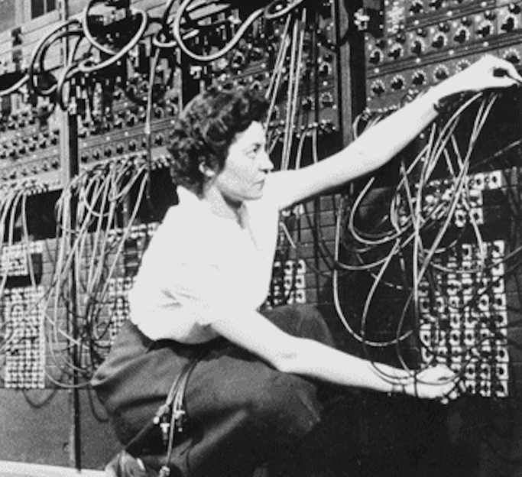
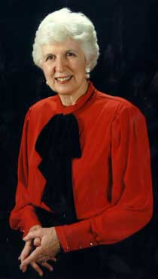
Women
Kathleen
“Kay” Antonelli
To change pictures:
Save the picture of the person you wish to use.
Single-left-click the grouped picture/shapes you wish to change on the poster. Single-left-click again on the picture.
Now single-right-click the picture and select “Change Picture” from the menu.
Choose the picture file you saved.
You may wish to single-left-click the grouped picture/shapes and single-left-click the new picture again to adjust its size or crop it—especially useful if the new picture is not the same aspect ratio as the previous one.
DO NOT CHANGE ROSIE THE RIVETER PICTURE!!!
In Technology
1940s Took every mathematics course offered at Chestnut Hill College for Women
1942 Applied math calculating ballistic trajectories as a human “computer”
1945 Selected as first ENIAC programmer
She broke down complex differential equations into the smallest possible steps. Each of these had to be routed to the proper bank of electronics and performed in sequence, not simply a linear progression but a parallel one. Every datum and instruction had to reach the correct location in time for the operation that depended on it, to within 1/5000th of a second.
During her work programming the ENIAC, Kay McNulty is credited with the invention of the subroutine. Her colleague, Jean Jennings, recalled when McNulty proposed the idea to solve the problem where the logical circuits did not have enough capacity to compute some trajectories.
What paths will you trailblaze that no one has traveled before?

